Slide 2
Feature Engineering
By Xu Shen

Slide 3
Agenda
Homework Review
Feature Engineering Introduction
Common Techniques
Feature Engineering on Benz Dataset

Slide 4
Homework Review
Write your own data visualization program based on benz dataset and lecture lab jupyter notebook.
Add description for what you are visualizing and how does this image could help predict your target variable in the challenge.

Slide 5
Feature Engineering
Understand the problem and use your domain knowledge before building predictive models
A feature, predictor or independent variable is information that might be useful for prediction

Slide 6
What you should do in feature engineering?
Data transformation for individual predictors
Data transformation for multiple predictors
Dealing with missing values
Removing predictors
Adding predictors
Binning predictors
Computing predictors

Slide 7
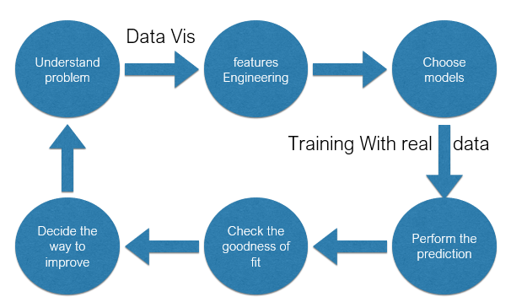
Feature Engineering

Slide 8
Data Transformation for Individual Predictors
Centering and Scaling
Transformation to resolve skewness

Slide 9
Data Transformation for Multiple Predictors
Transformation to resolve outliers-Spatial Sign Techniques

Slide 10
Dealing with missing data
Why the data is missing? This is very informative
Imputation techniques(mini modeling process)

Slide 11
Removing Predictors
Get a more parsimonious and interpretable model
Near-zero variance
Predictors with high correlations

Slide 12
Adding Predictors
Calculating the ratios
Calculating the probabilities
Reorder rate
Life time value

Slide 13
Homework Problems-Application
What can we do after learning the above-mentioned techniques on the Benz Data Set?

